Slide 1
Kingsley Okoro
Absorb ML Challenge

Slide 2
Problem Statement
Developing a predictive pricing model for items on an online platform.
Dataset contained a mixture of structured and unstructured data(mainly text).
Dataset is a table with product listing with each data point describing exactly one listing.

Slide 3

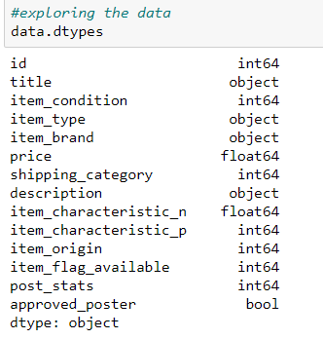
Dataset
Dataset contains 1482535 data points and 14 features.
Data set contains integer, float, string and bool data types.

Slide 4
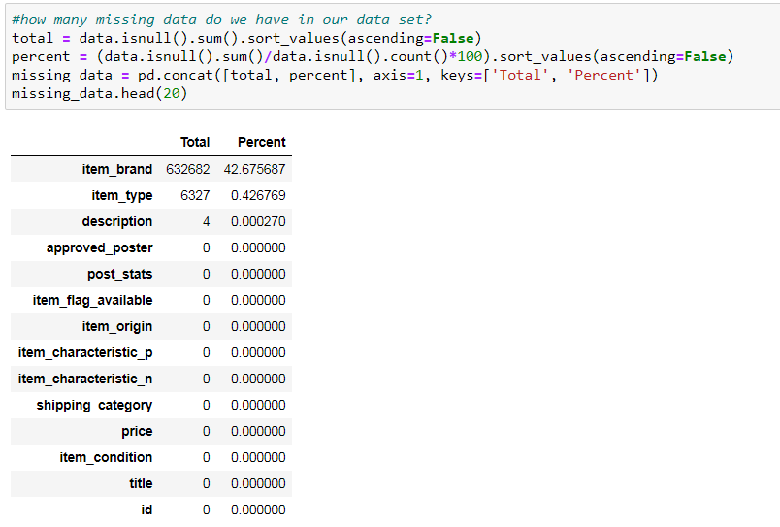

Missing Data?
Dataset contained missing values.
The item_brand feature had most the missing values with (42%), item_type had 0.426% and description had only 4 observation missing.
I decided to drop the item_brand feature (column) and observations for item_type and description

Slide 5
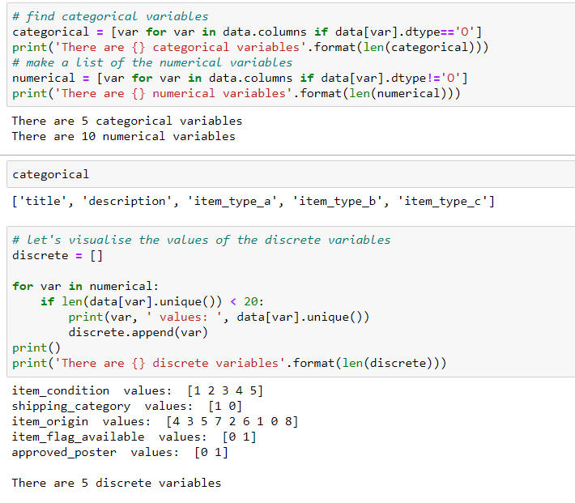

Categoriacal, Numerical and Discrete Observations

Slide 6
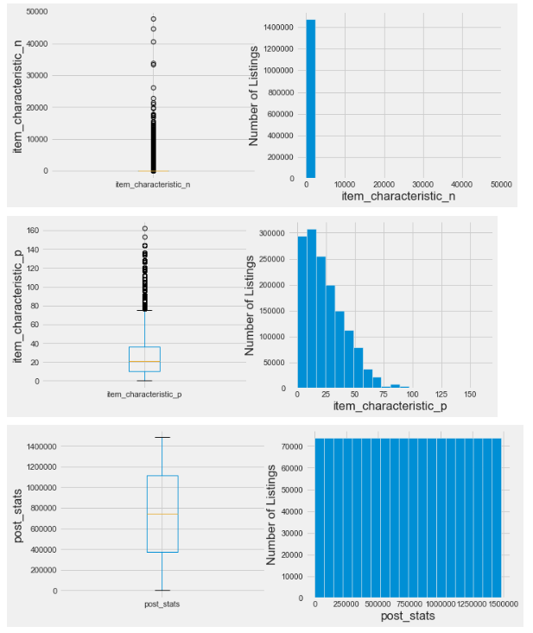
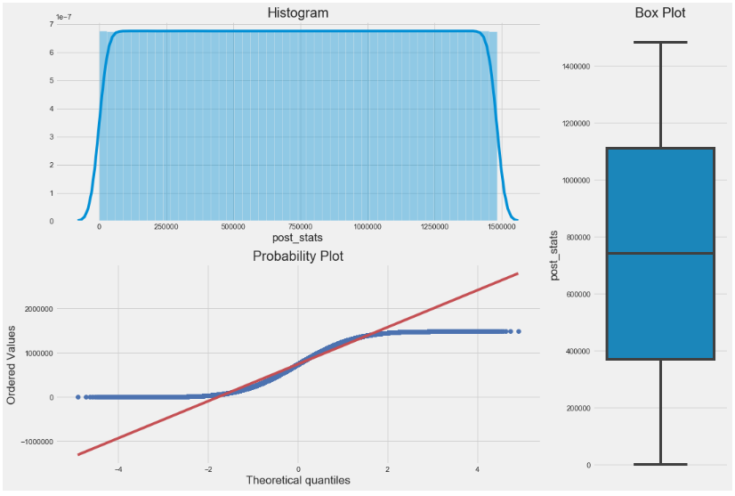
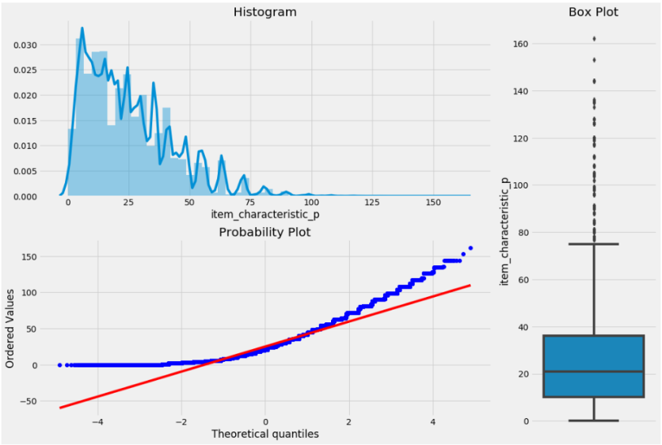
Exploratory Data Analysis (Visualizations)

Slide 7
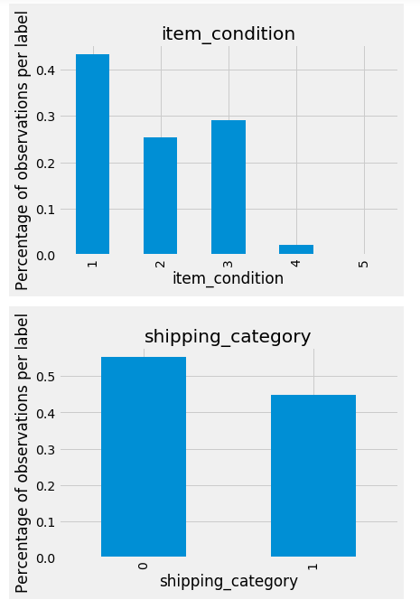
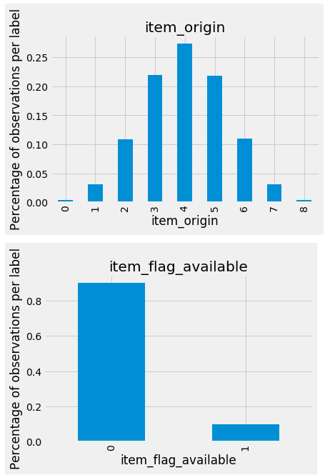
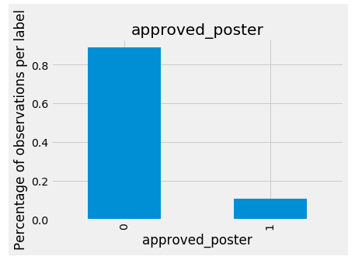
EDA Continued(other features Variables)

Slide 8
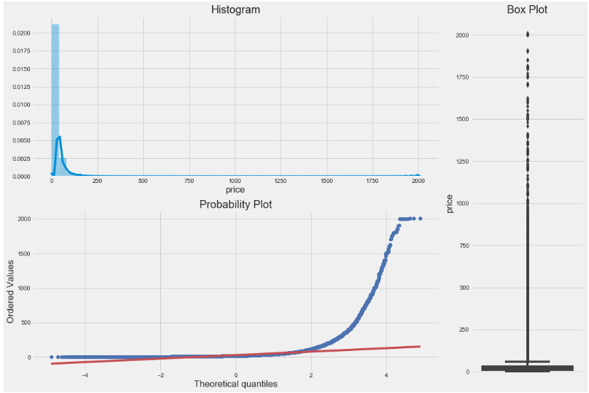
EDA continued(Target variable Price)
Target variable price not normally distributed.
Target variable is right skewed
There are multiple outliers in the variable
Linear models are based on the assumption that normality exists.

Slide 9
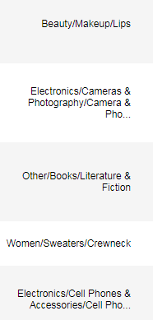
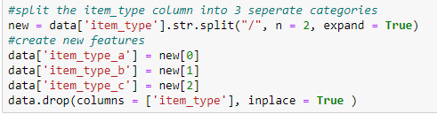
Feature Engineering
Performed integer encoding
Created new features from item_type column, item_type_a, item_type_b, item_type_a
More feature engineering can be done leveraging domain knowledge.

Slide 10
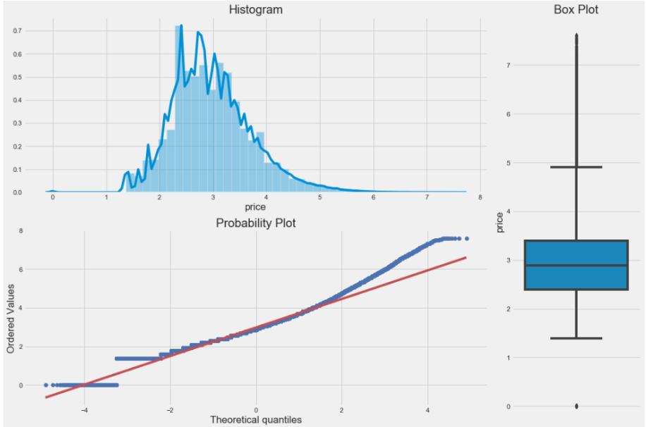

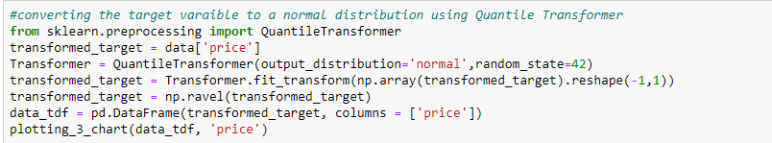
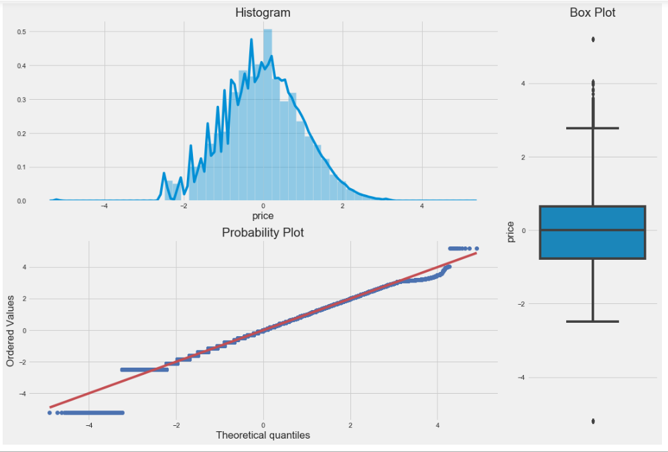
Feature Engineering Cont’d
Tried using logarithmic transformation and quantile transformer to transform data to follow a gaussian distribution .

Slide 11
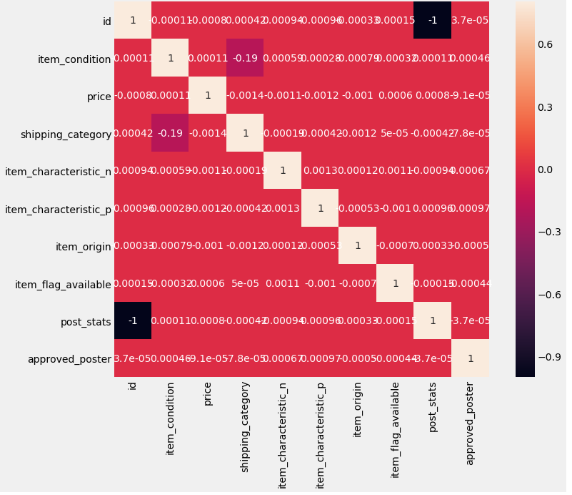
Co-Linearity?
Heatmap with pearson correlation to investigate correlation between independent variables.

Slide 12
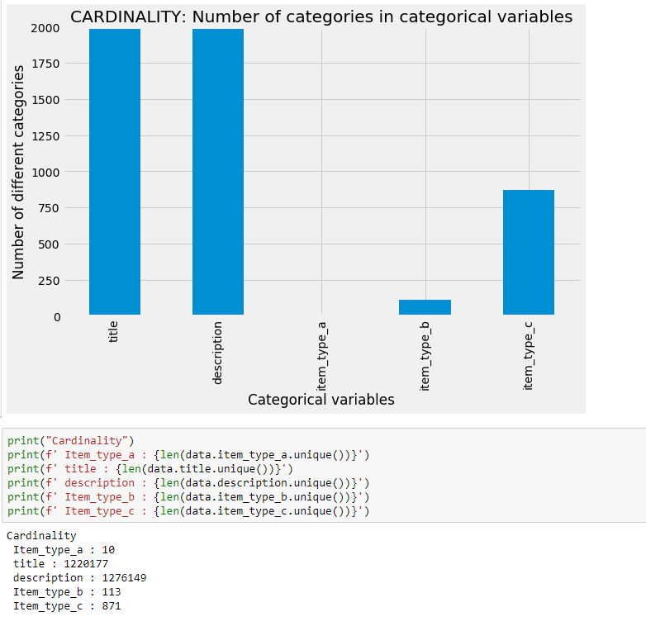
Cardinality
Drop features with high cardinality as they distort linear models

Slide 13
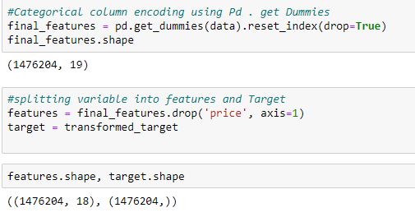
Final feature Selection
Use Pd.get_dummies similar to one_hot or Lable Encoding to handle categorical data.

Slide 14
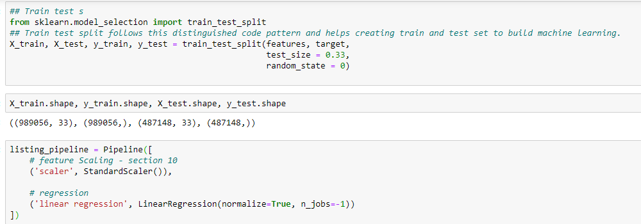
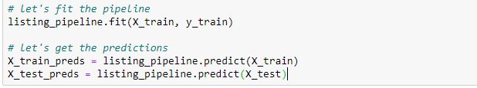
Model Training(simple Linear Regression)

Slide 15
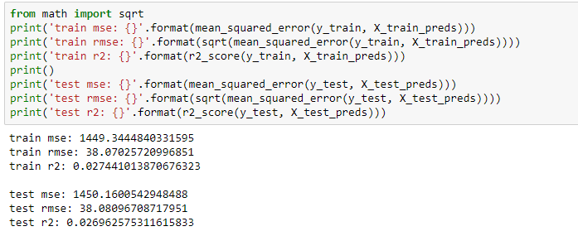
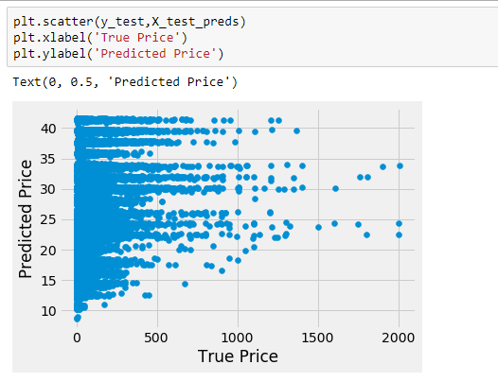
Model Evaluation(skewed target)

Slide 16
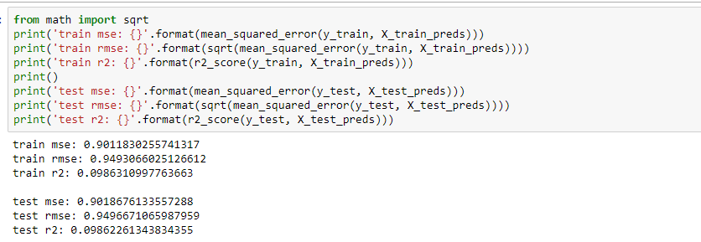
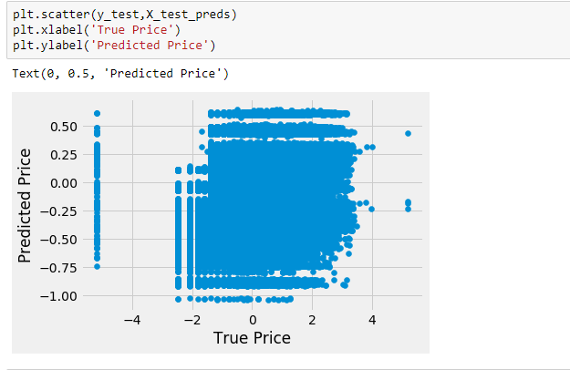
Model Evaluation(normalized target)

Slide 17
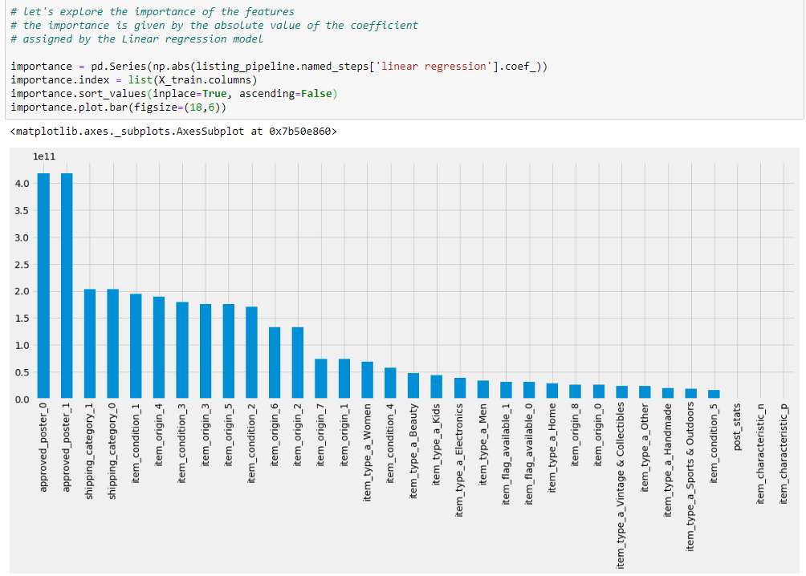
Feature Importance

Slide 18
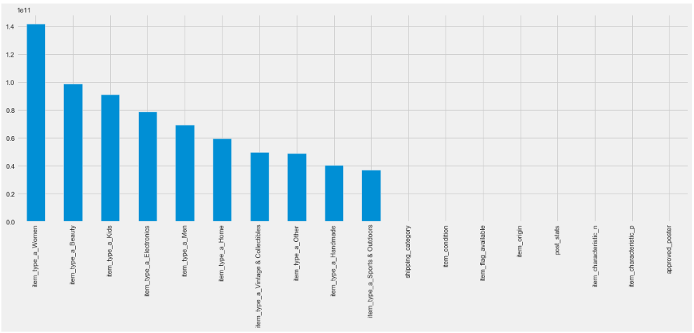
Feature Importance

Slide 19
Thank You
Questions?

